Slide 1
Robust Contour Discovery for Plan Bouquets
Achint Chaudhary
M.Tech.

Slide 2
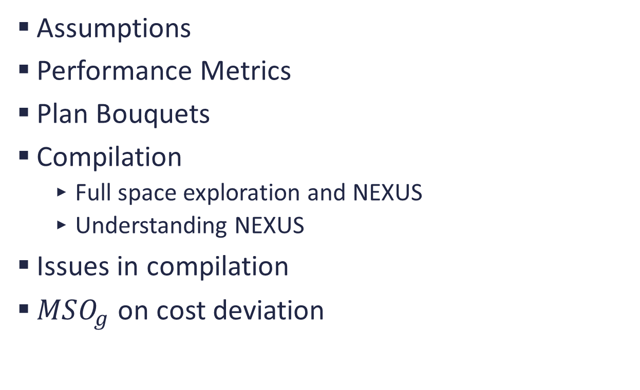
Outline
Assumptions
Performance Metrics
Plan Bouquets
Compilation
Full space exploration and NEXUS
Understanding NEXUS
Issues in compilation
$MSO_{g}$ on cost deviation

Slide 3
Assumptions
Plan Cost Monotonicity (PCM)
Axis Parallel Concave (APC)
Perfect Cost Model of Optimizer
Bounded Cost Growth (BCG)
Piece-wise Axis Parallel Linear (APL)
Selectivity Independence

Slide 4
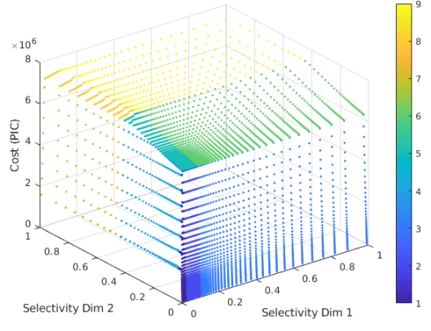
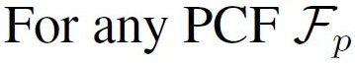
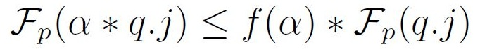
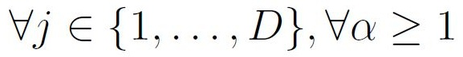
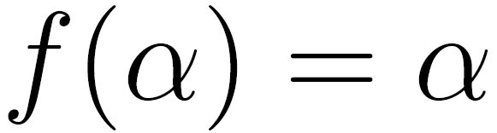
Linearity & BCG of OCS
Common observation is
(a) Exemplar piecewise linear OCS
(b) Definition of BCG
Note: APL and BCG behavior of Plan Cost Functions implies similar behavior of OCS

Slide 5
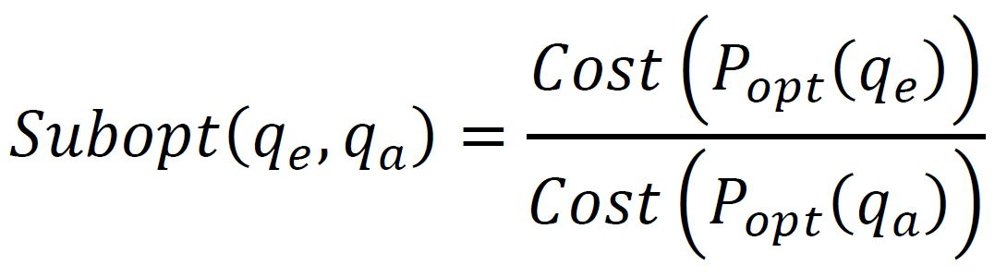
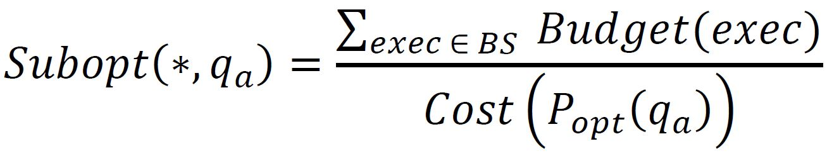
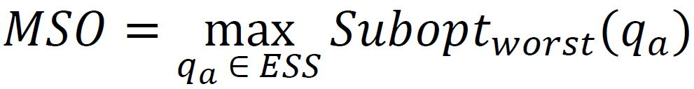
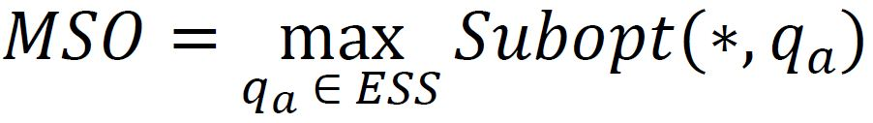
Performance Metrics
Suboptimality
Worst Suboptimality
Maximum Suboptimality (MSO)

Slide 6
Plan Bouquets

Slide 7
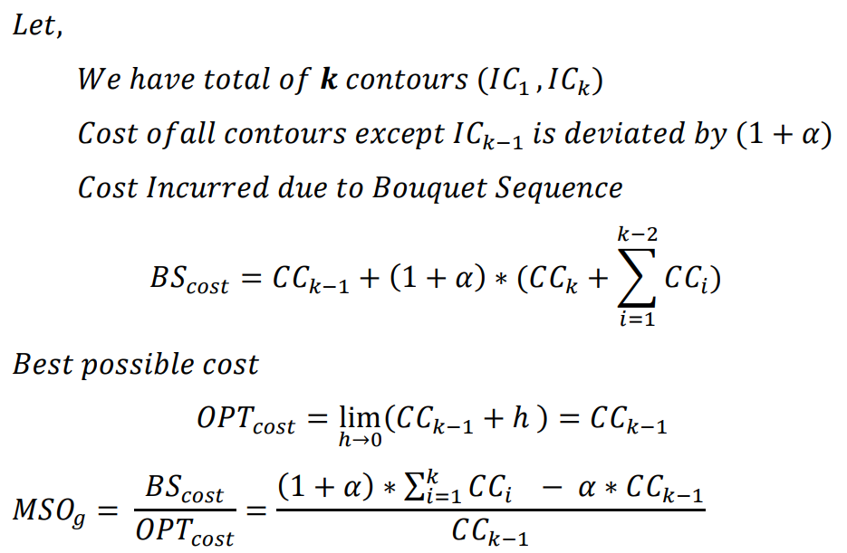

$MSO_{g}$ on Cost Deviation

Slide 8
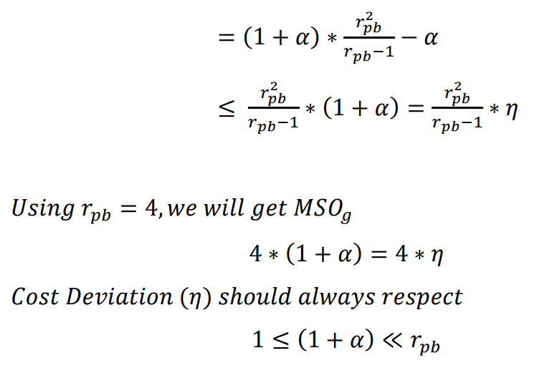

Slide 9
Bouquets Compilation
Full Space Exploration
NEXUS

Slide 10
NEXUS Algorithm

Slide 11
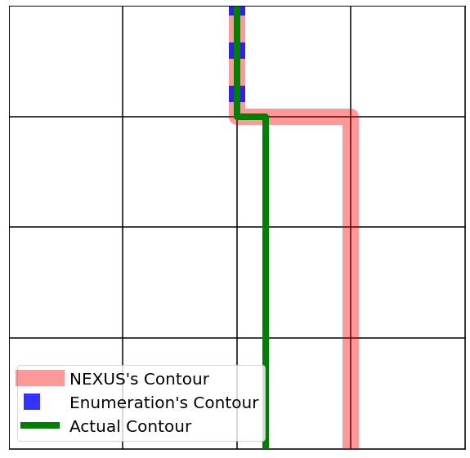
Issues in compilation
Hello

Slide 12
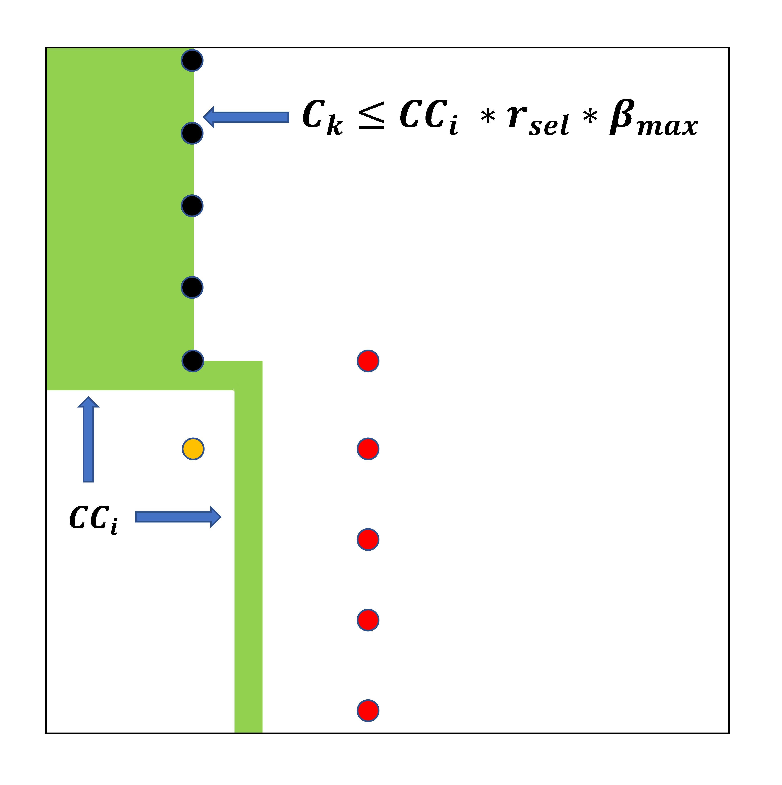
NEXUS Cost Deviation
NEXUS uses

Slide 13
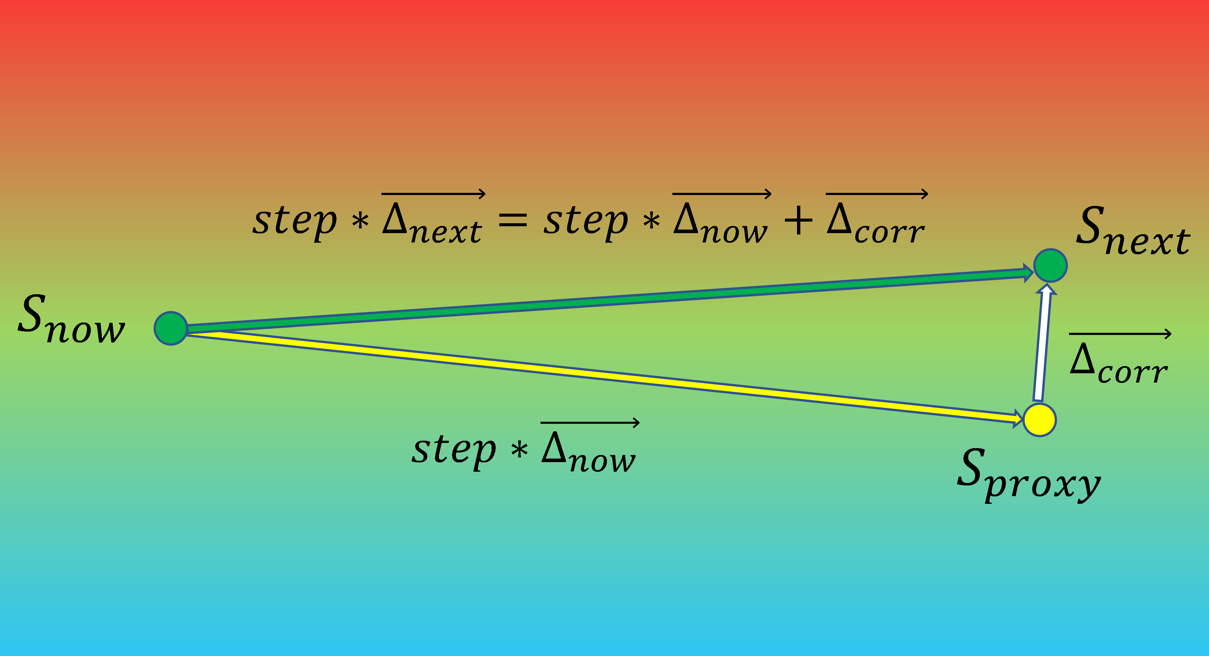
Scope & Idea for AdaNEXUS
Hello

Slide 14
Experiments

Slide 15
Thank You!

